Slide 1
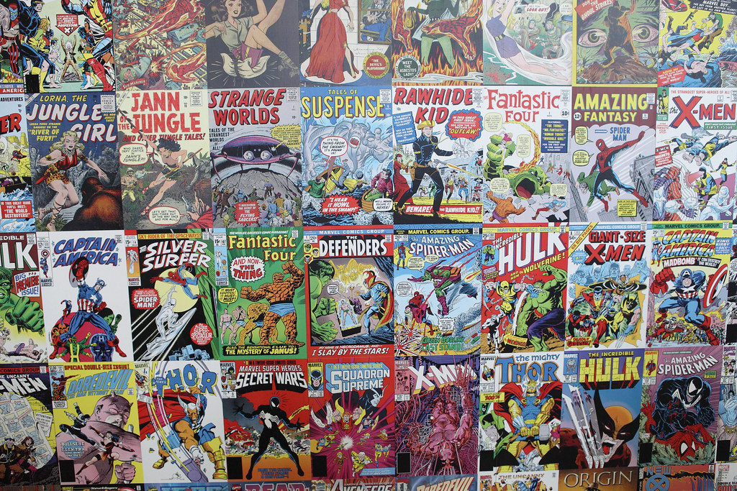
New Comic Book Shop
By D.Billings
Data Analyst
This Photo by Unknown Author is licensed under CC BY

Slide 2
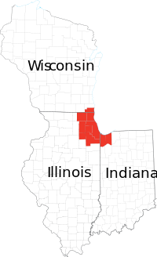
Goals
Investors want to open a new store in Wisconsin or N. Illinois
The prime locations are the cities of
Chicago
Madison
Milwaukee
We want to be
Considering where movie theaters are
Other comic book stores
This Photo by Unknown Author is licensed under CC BY-SA

Slide 3
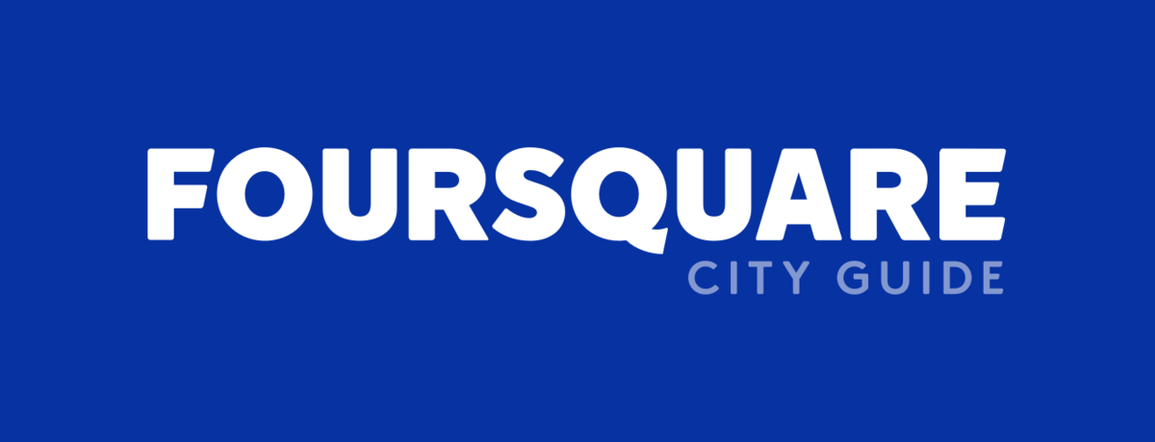
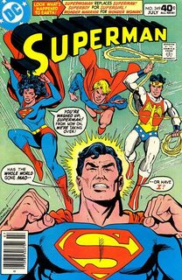
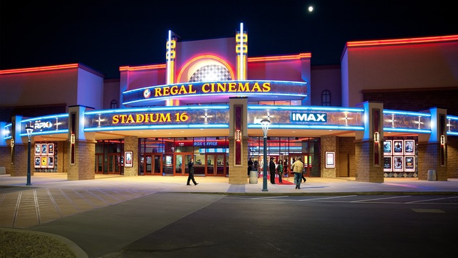
Methodology
FourSquare provides the best location data available to determine the distances between stores in the three cities
We can locate all of the current stores and movie theaters
We want to locate where the mean coordinations for the movie theaters are so that our customers can come from any of the theaters and not just a small segment
We also want to be as far away from a competitor as possible as we build a brand
This Photo by Unknown Author is licensed under CC BY-SA
This Photo by Unknown Author is licensed under CC BY-SA
This Photo by Unknown Author is licensed under CC BY-SA

Slide 4
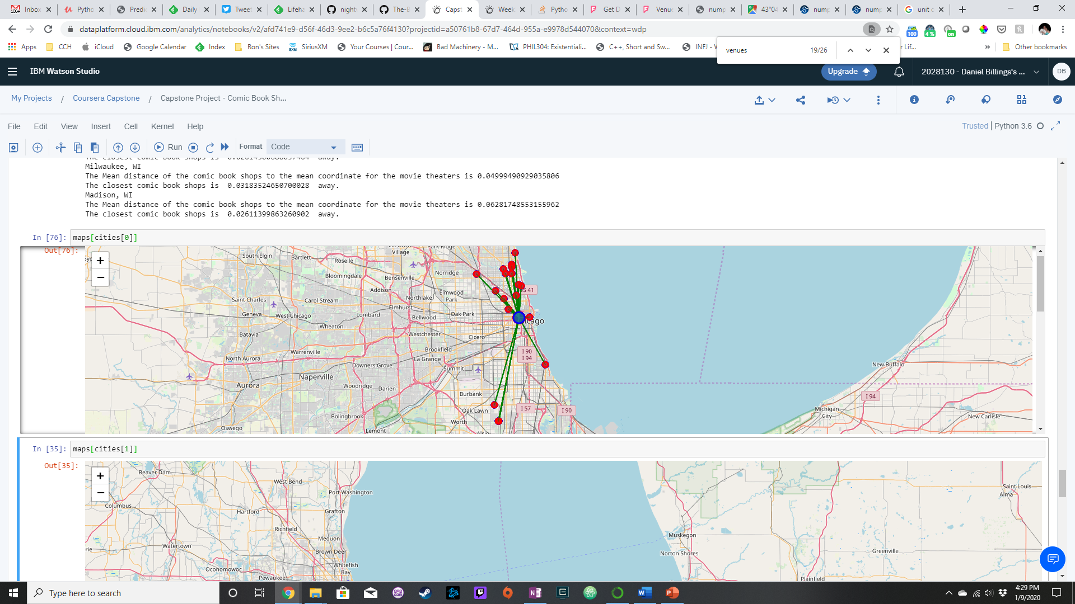
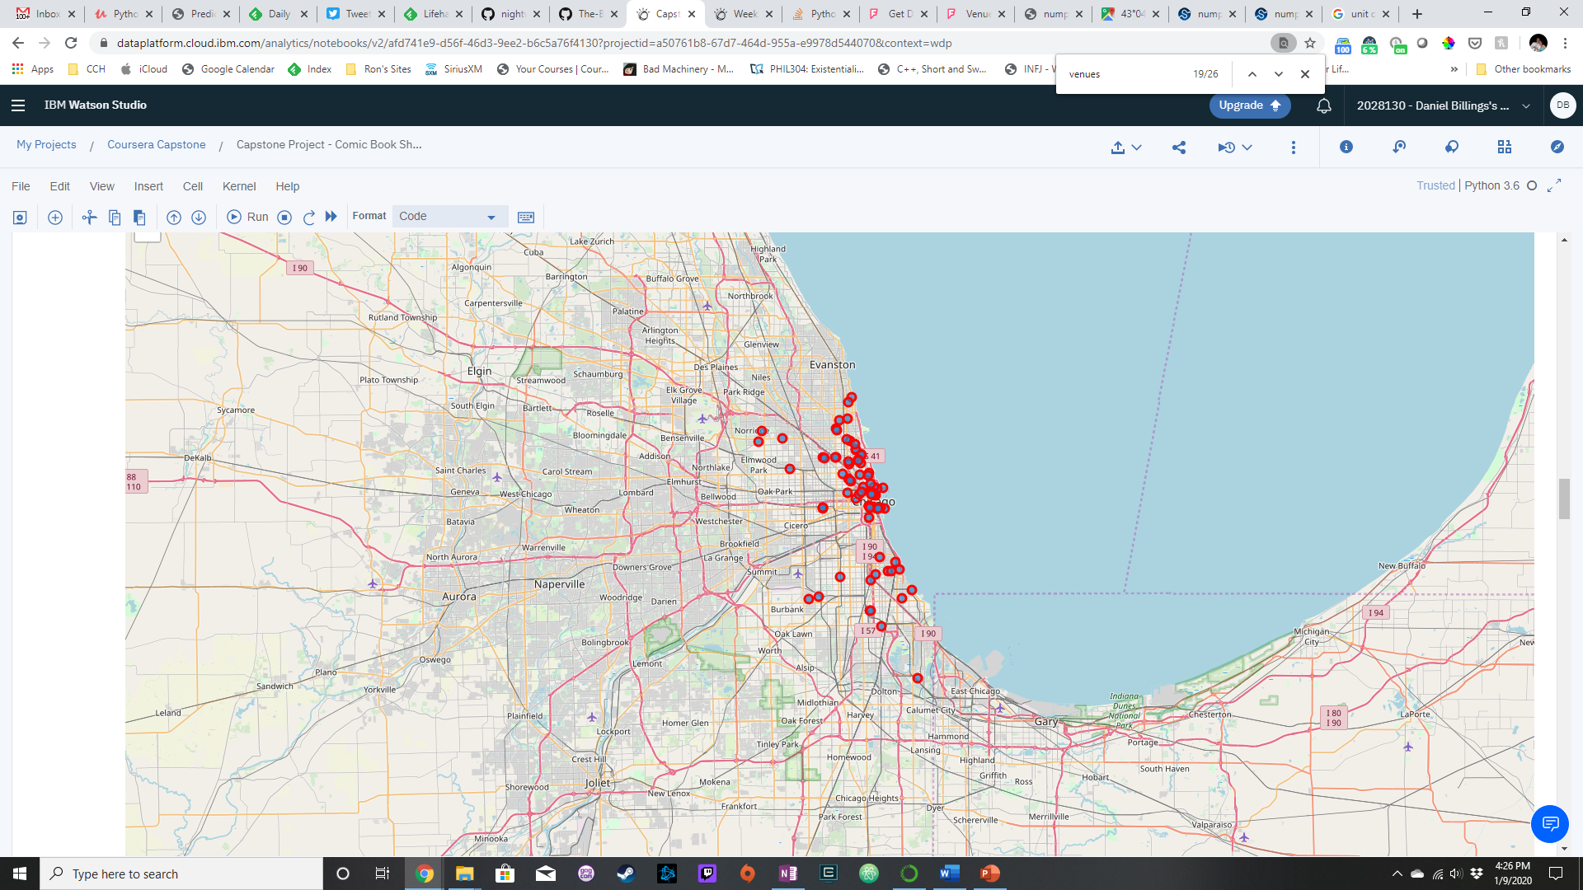
Chicago
The most stores; the most theaters; store currently close to mean
Movie locations
Comic Shops to Mean Movie
MEAN
0.09545175878276443
MINIMUM
0.02614300688037464

Slide 5
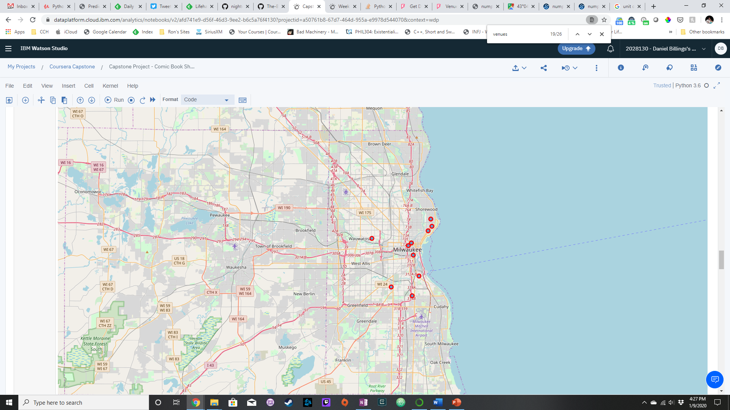
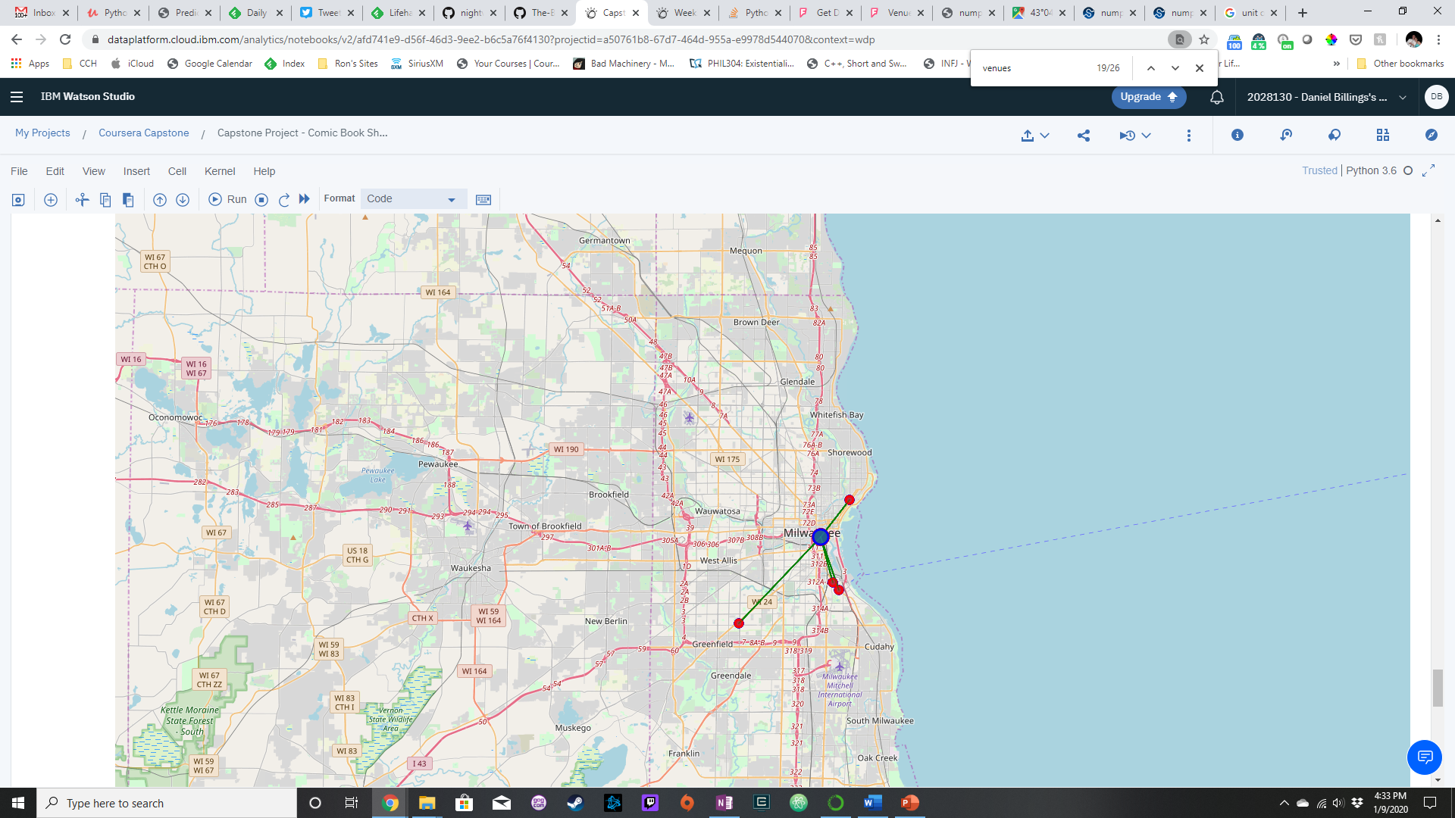
Milwaukee
Less competition; minimum is close to average, which is larger than others
Movie theater locations
Comic Shops to Mean Movie
MEAN
0.04999490929035806
MINIMUM
0.03183524650700028

Slide 6
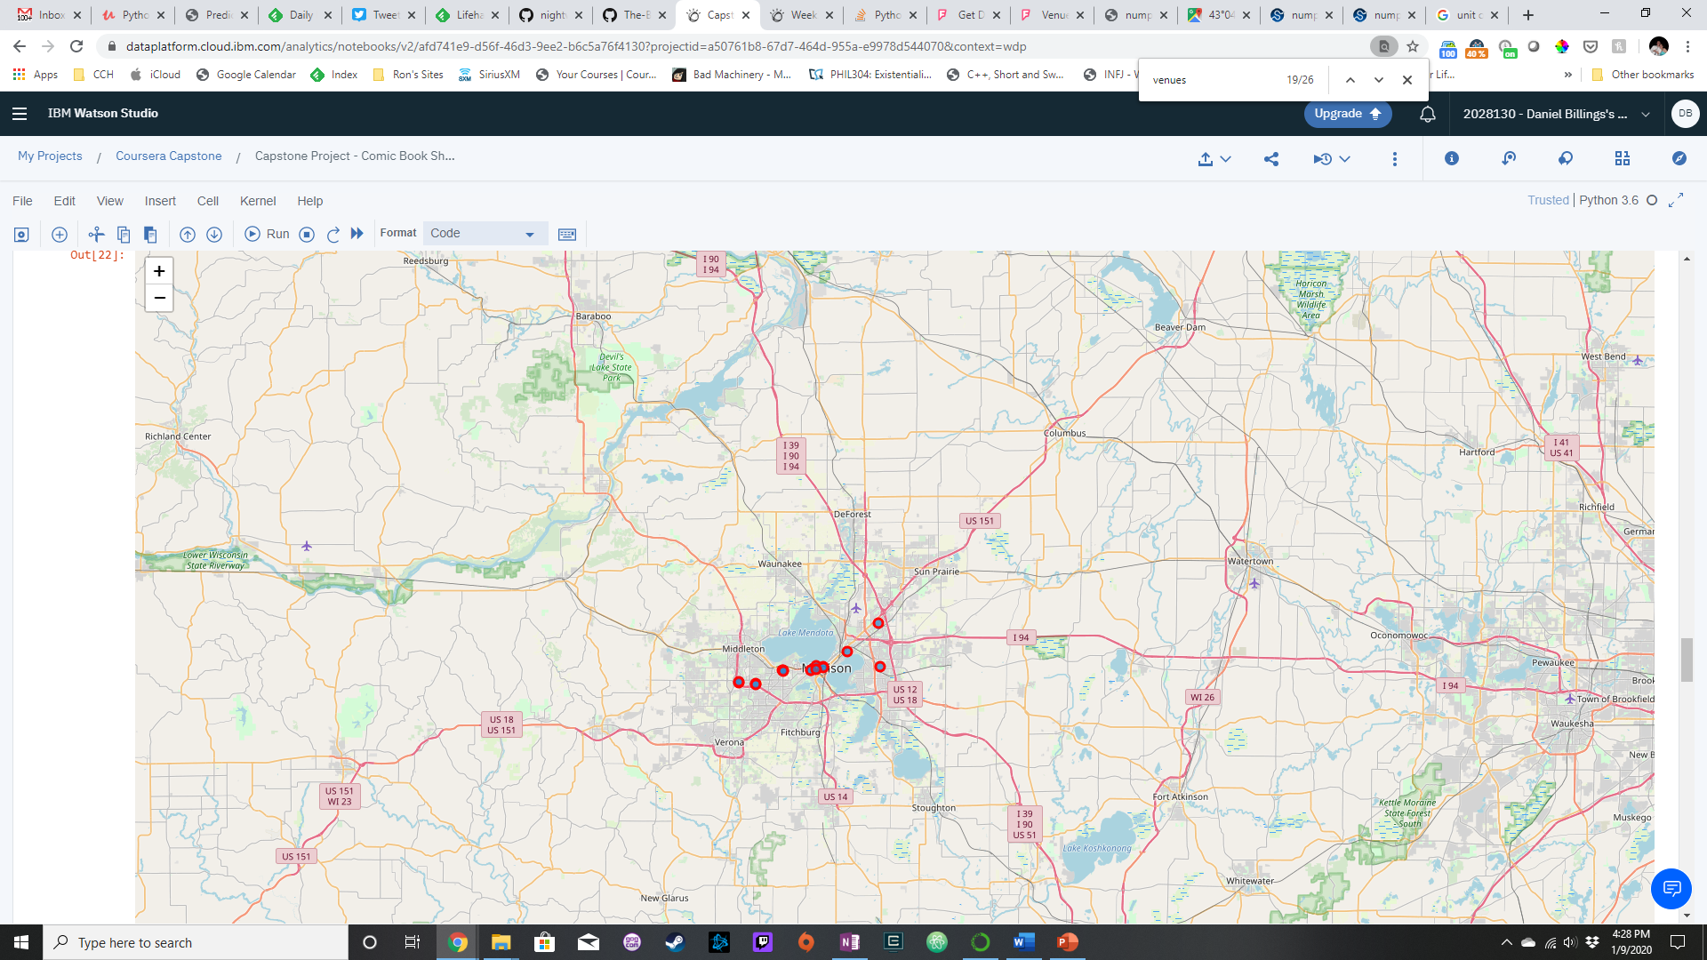
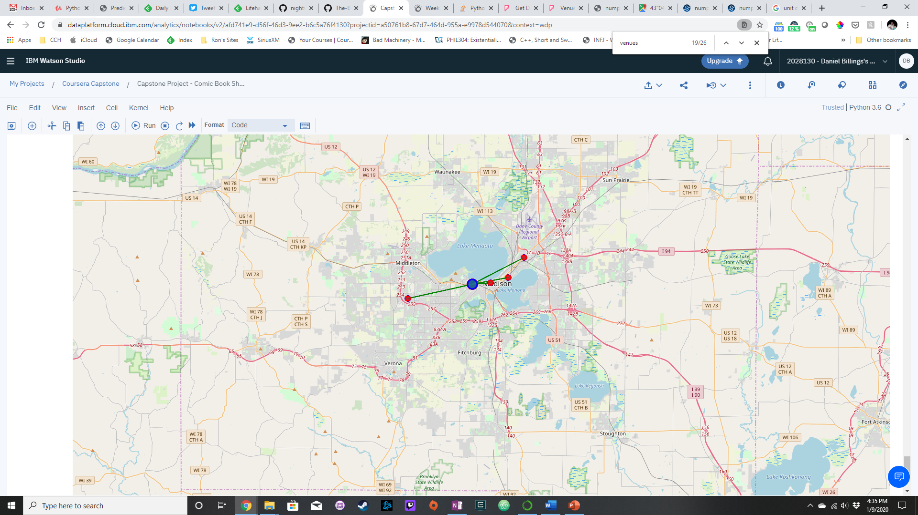
Madison
Outliers far from movie theaters; competition closest of three
Movie theater locations
Comic Shops to Mean Movie
MEAN
0.06281748553155962
MINIMUM
0.02611399863260902

Slide 7
Conclusion
Milwaukee offers us the best location
Most of the shops are equidistant from the mean coordinate of the theaters
With only four in the city, we have less competition with a good number of theaters
If we open a store near the mean, we won’t have nearby competition

